Slide 1
Large-Scale Optimization for Machine Learning
Amirkabir Artificial Intelligence Student Summit 2021
Sina Baharlouei
Daniel J. Epstein Department of Industrial Engineering
1

Slide 2
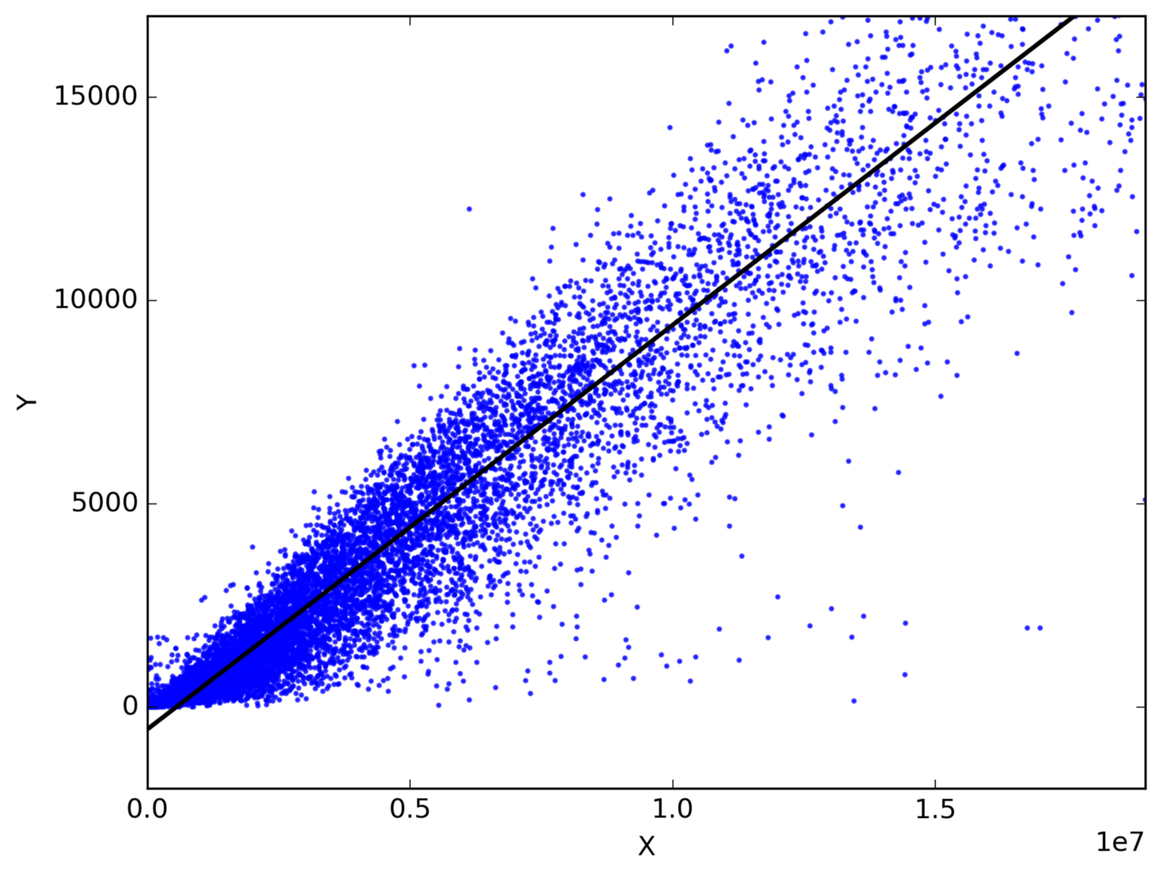
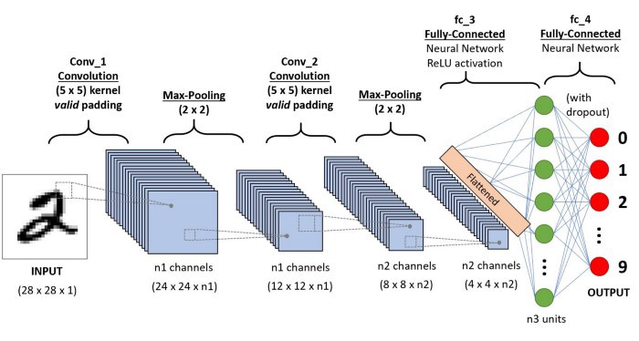
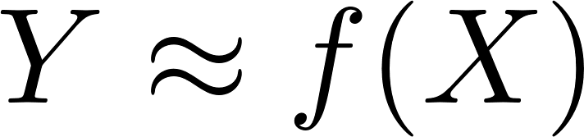
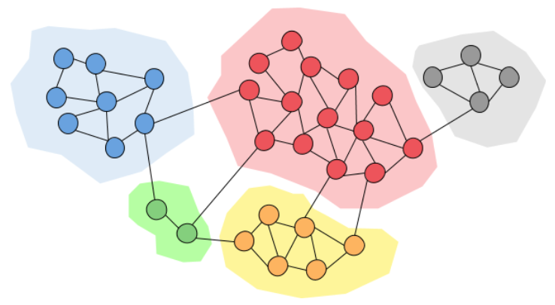
Supervised and Unsupervised Learning Tasks
2

Slide 3
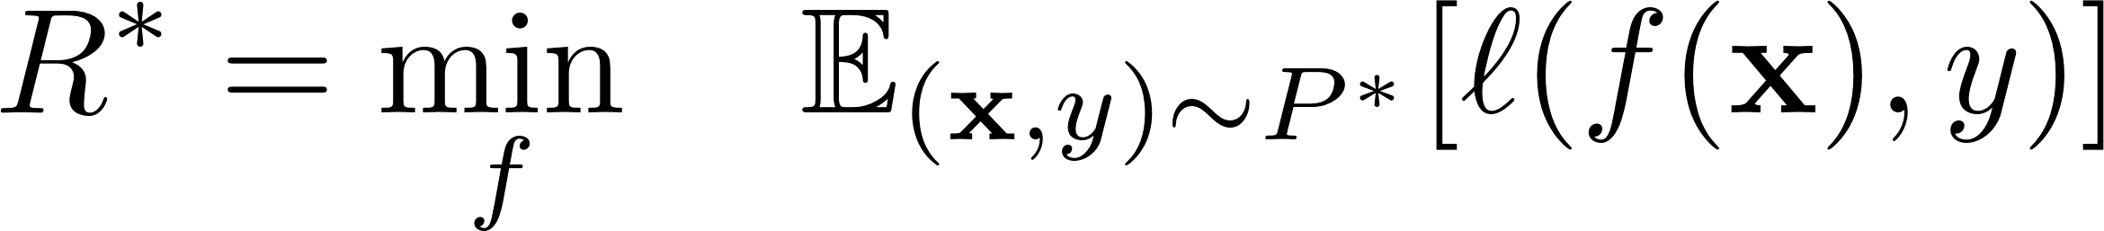
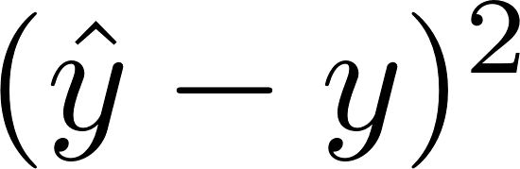
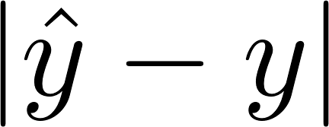

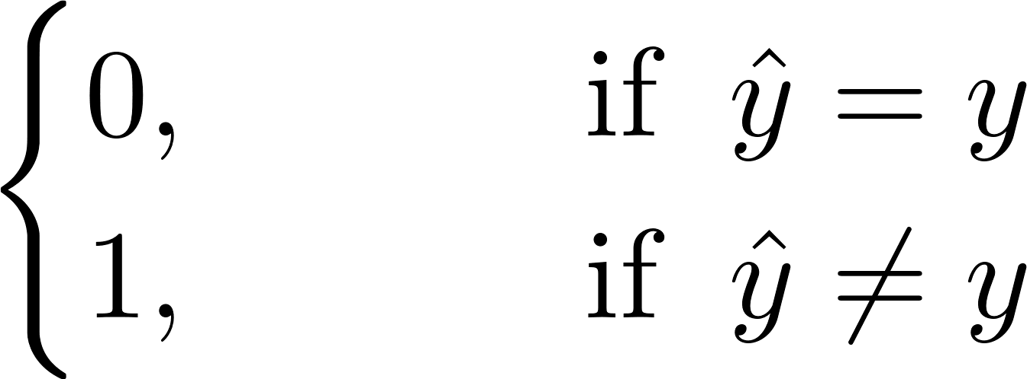
Population Risk
Feature (input) vector
Mapping (learnable)
Ideal problem in theory:
Joint Distribution of x and y
Label, output variable
Bayes error: still, it can be wrong!
Not usable in practice! Why?
3

Slide 4
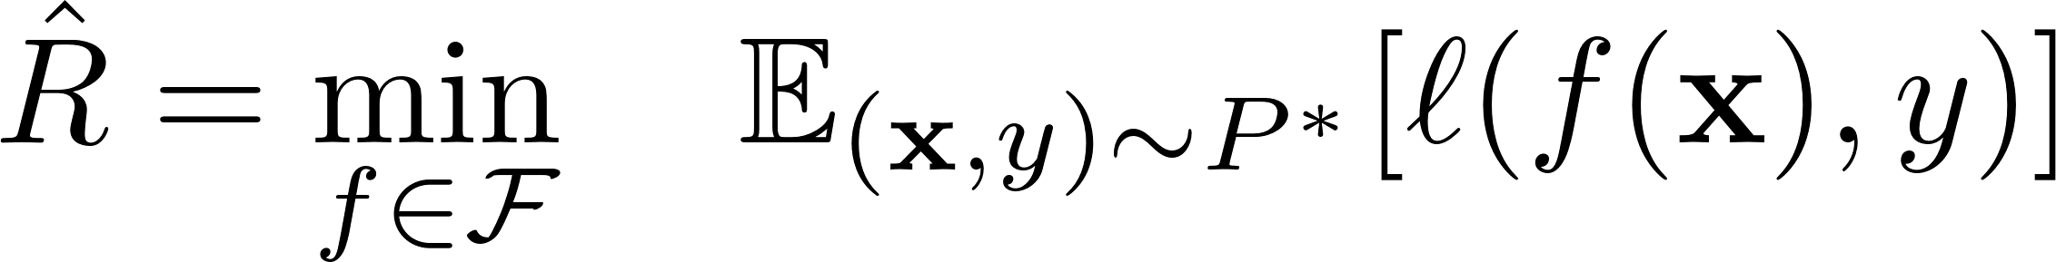
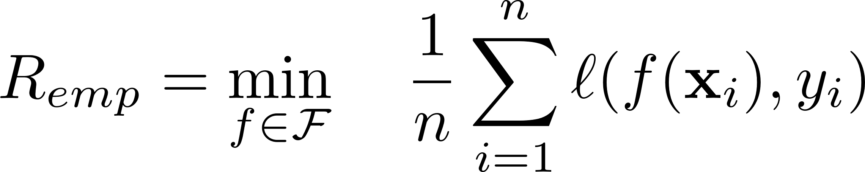
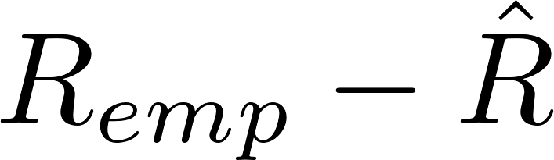
From Population Risk to Empirical Risk
Approximation error:
A (parametric) functional space:
Set of all linear functions
All 2-layer neural nets
Estimation Error:
No Access to P*
n available samples from P* (training data)
Empirical Risk Minimization
4

Slide 5

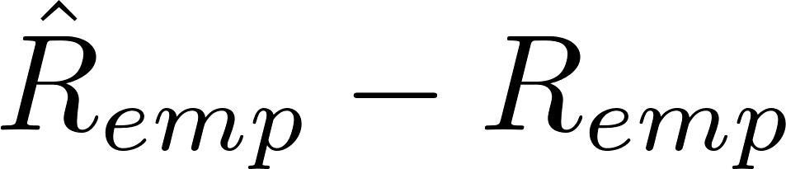
Optimization Error
Optimization Error:
Can we solve the above problem exactly?
Distance from global optimum within the hypothesis class:
Approximation Error
Estimation Error
Optimization Error
5

Slide 6
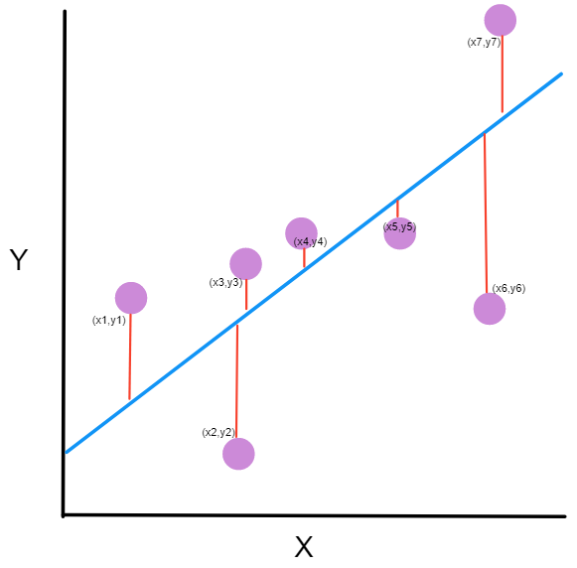
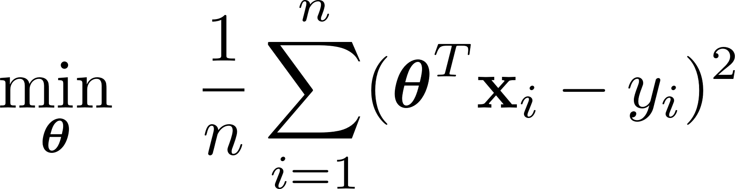
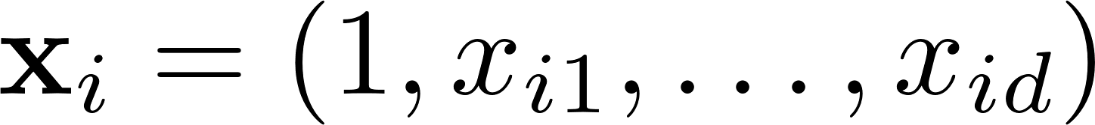
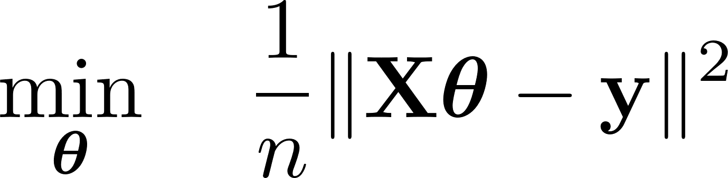
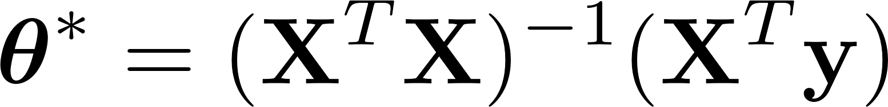
A Few Examples (Linear Regression):
Why?
Very easy to solve:
6

Slide 7
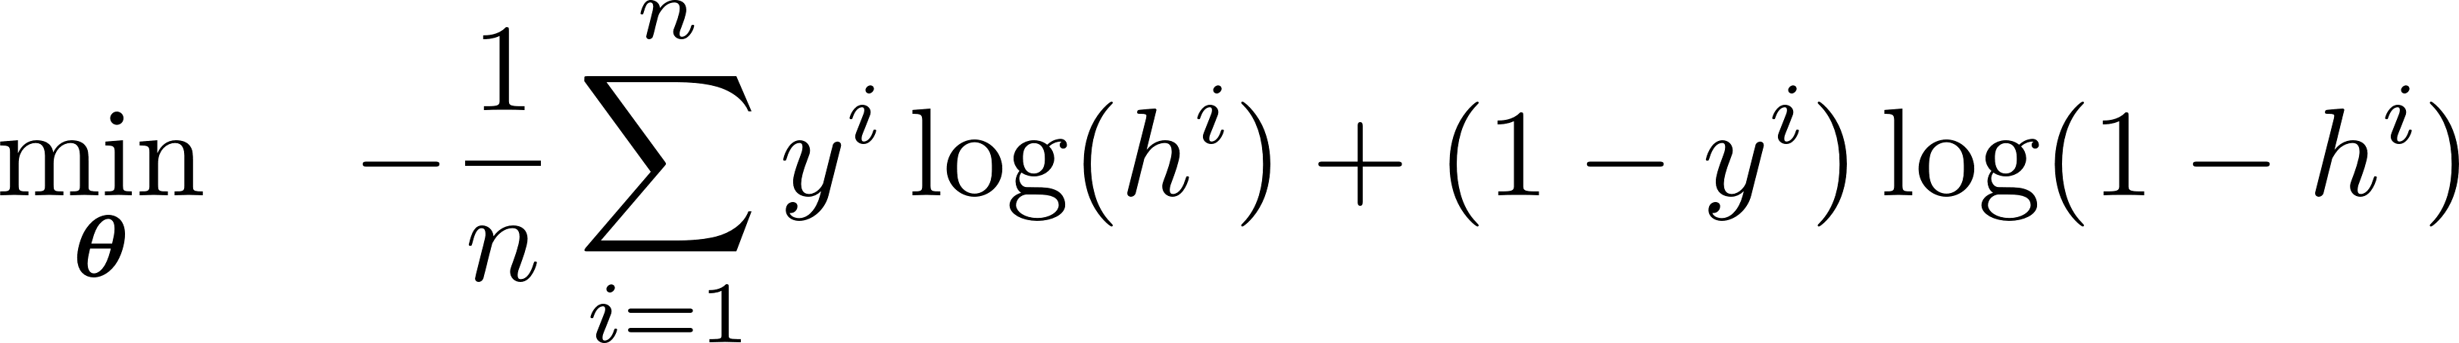
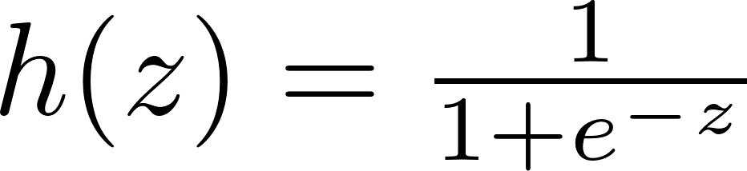
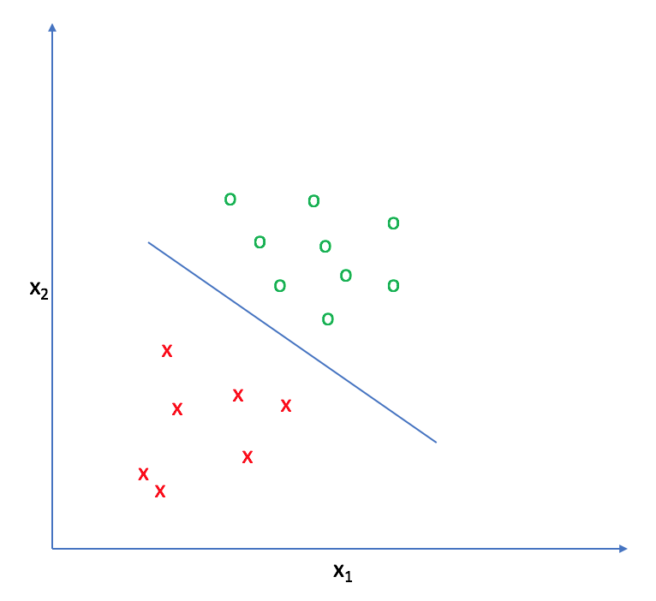
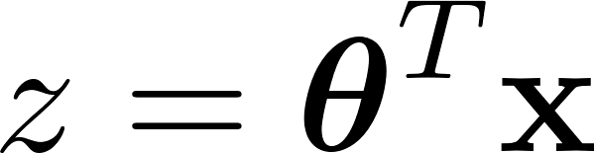
A Few Examples (Logistic Regression):
What’s the connection with linear regression?
7

Slide 8
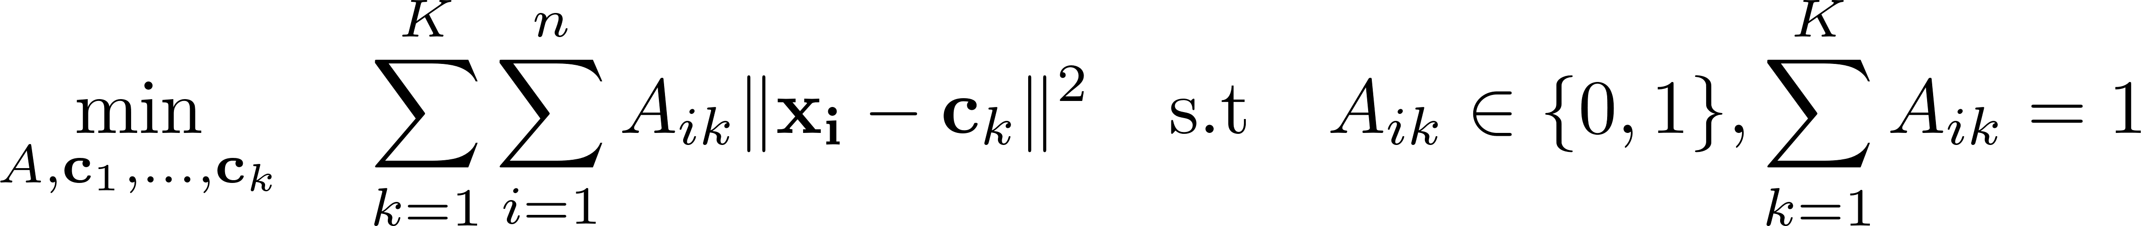
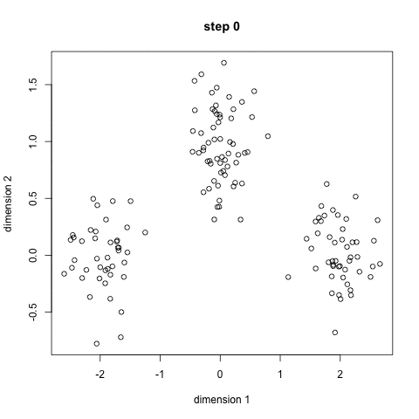
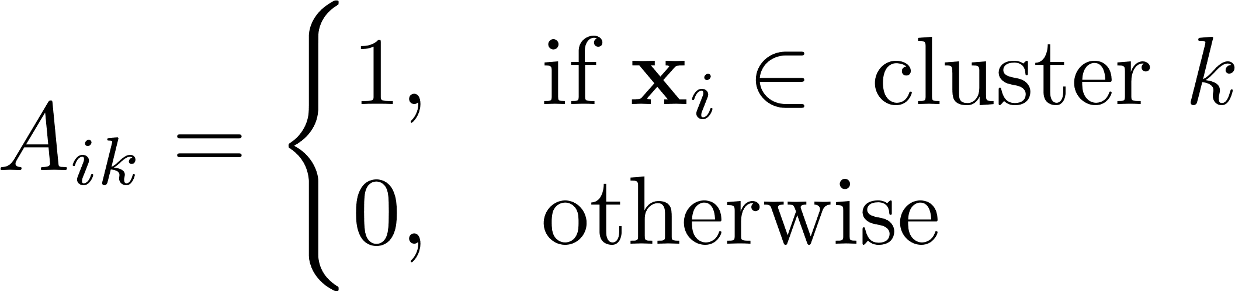
Clustering:
Binary constraint (extremely hard to handle)
NP-hard in general
How does k-means work?
8

Slide 9
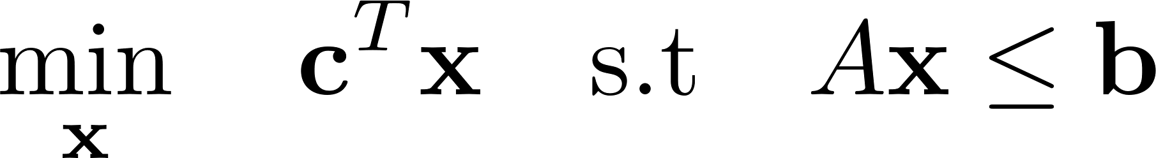
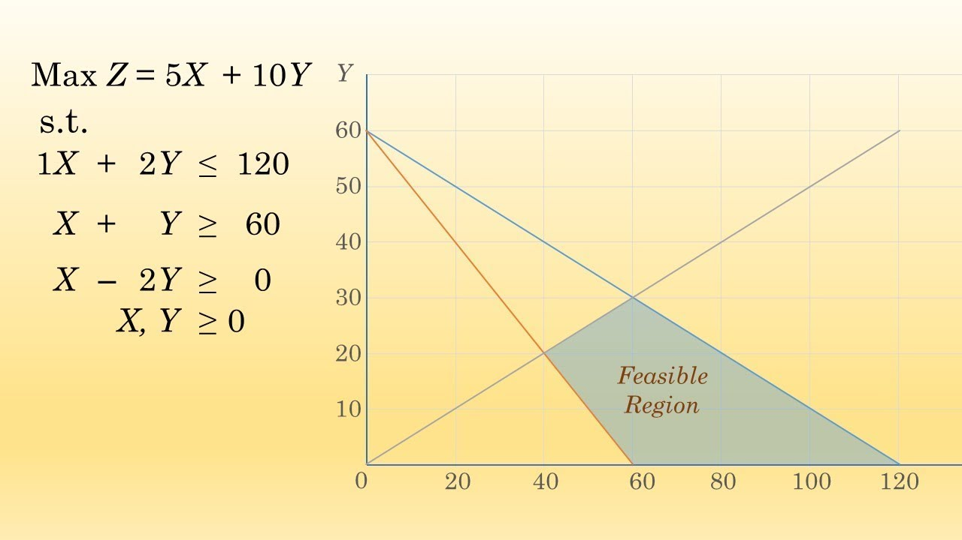
Linear Programming
George Dantzig (US Army Air Force): Mechanize the planning process.
Exponential complexity (2^d) in the worst-case, but practically fast!
9

Slide 10
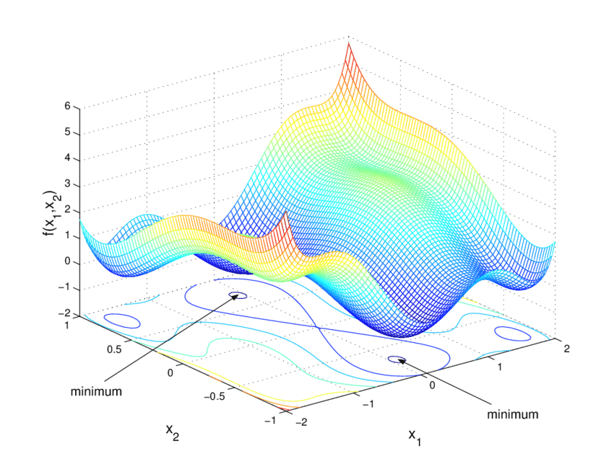
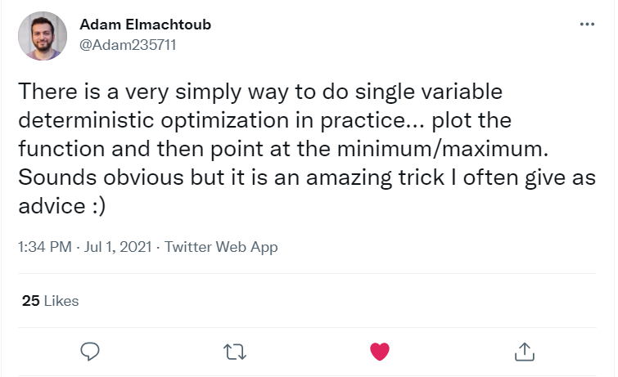
Beyond Linear Programming
Non-linear Programming?
Large class of problems with no general efficient algorithms?
Is there any easier class with tractable problems?
10

Slide 11
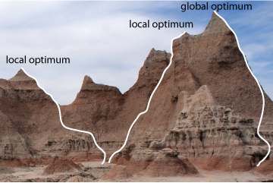
Why Convex Optimization?
A class of optimization problems can be solved efficiently and accurately.
Polynomial-time algorithms
Can be solved to global optimality
All local optima are global for convex problems!
11

Slide 12
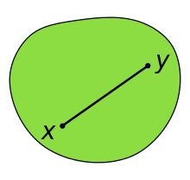
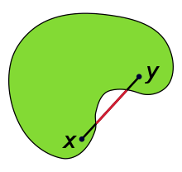
A Brief Review of Convex Optimization
Definition of convex set:
It makes sure we stay inside the set by choosing a point between any two given points.
12

Slide 13
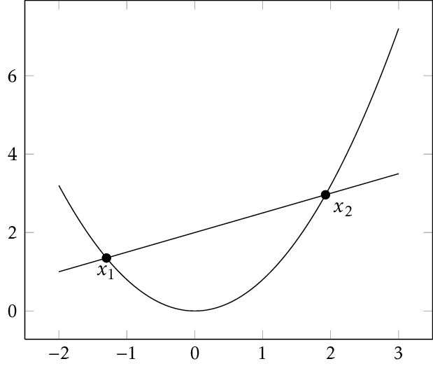
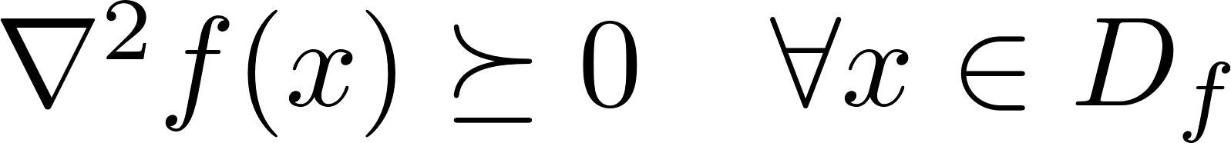
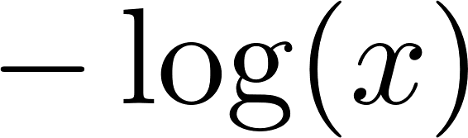
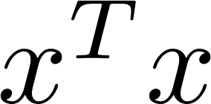
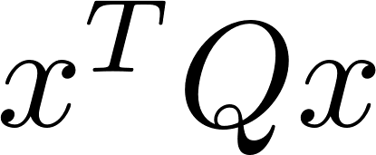


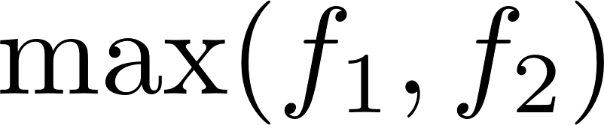
A Brief Review of Convex Optimization
Definition of convex function:
First-order definition:
Second-order definition:
How many of these functions are convex?
13

Slide 14
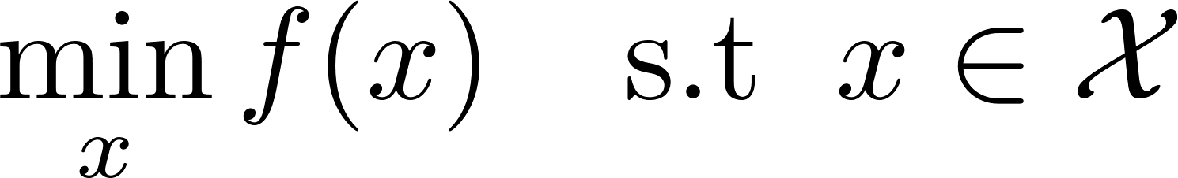
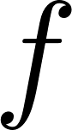
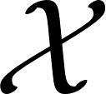
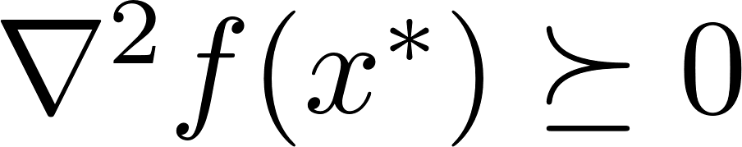
A Brief Review of Convex Optimization
Convex problems:
Function must be a convex function.
Set must be a convex set.
First-order optimality condition:
Second-order optimality condition:
All local minima of a convex problem are global minima (why?)
We can find local minima of convex problem and we are done!
14

Slide 15
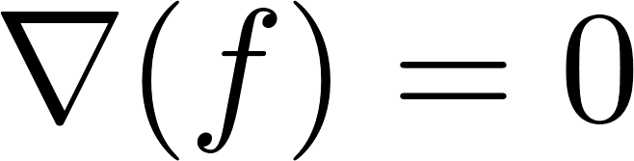
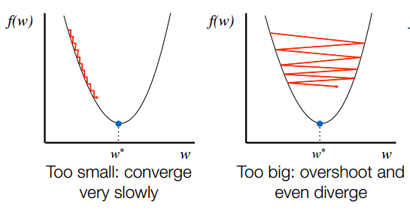
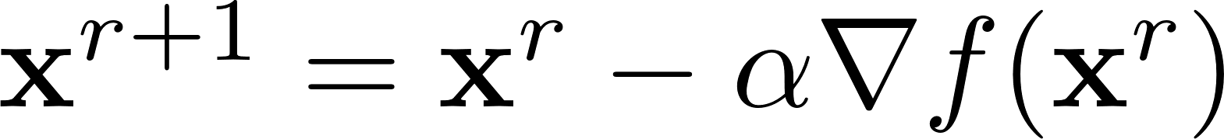
First-Order Methods
How to find a local minimum?
Solving:
What is the meaning of positive gradient (for any given entry)?
A better (smaller objective value) point by going to the opposite direction of the gradient.
Step-size
15

Slide 16
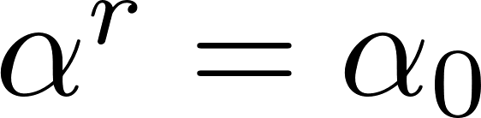
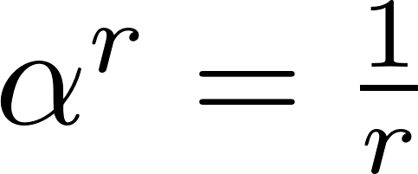
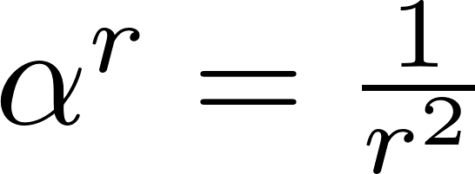
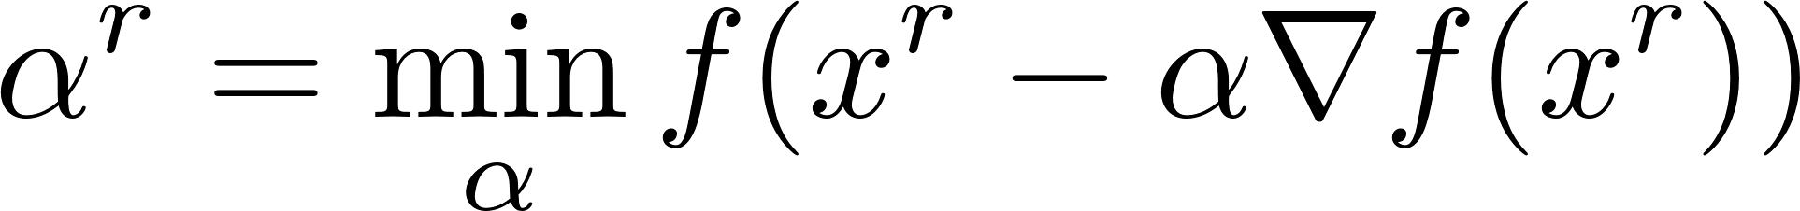
How to choose step-size?
Constant step-size:
Diminishing step-size:
What about ?
Exact line search:
Not the best global sequence of step-sizes
Armijo Rule:
16

Slide 17
Convergence of Gradient Descent for Convex Problems:
Lipschitz Continuity:
Gradient Lipschitz:
Descent Lemma:
17

Slide 18
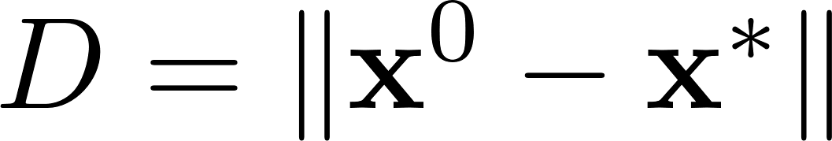
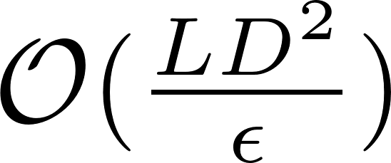
Convergence of Gradient Descent for Convex Problems:
Sufficient Descent (Based on Descent Lemma):
Let , f is Lipschitz gradient with constant L, then we require
to achieve an epsilon optimal solution.
From Descent Lemma:
18

Slide 19
Convergence of GD for Convex Problems (GD)
19

Slide 20
Cost-to-go (Based on the convexity)
Convexity
Last page inequality
20

Slide 21
Convergence Rate
21

Slide 22
Nesterov’s Acceleration Method:
22

Slide 23
Is GD optimal?
What’s the meaning of the lower bound?
“Worst function in the world” ☺
What was the convergence rate of the gradient descent?
Can we do better than GD?
23

Slide 24
Nesterov’s Acceleration Method
Using a linear combination of the previous gradients and values
How to find “good” coefficients?
Two stages: Extrapolation, gradient descent.
24

Slide 25

Case Study: A Simple Quadratic Programming
25

Slide 26




Convex But Non-smooth Optimization!
Remember the linear regression problem:
What if we have thousands of features (many irrelevant ones)?
Ridge Regression
Optimal Sparsity
Lasso Regression
Elastic Net
26

Slide 27
Proximal Gradient Descent
Proximal Gradient Descent:
Convex non-smooth
Convex smooth
27

Slide 28
Lasso Regression:
Shrinkage Operator (soft-thresholding):
28

Slide 29
Lasso Regression:
29

Slide 30


Netflix Prize Problem:
30

Slide 31


Netflix Prize Problem:
Highly non-convex
# non-zero eigenvalues!
Convexification
Sum of eigenvalues (like going from L0 to L1)
31

Slide 32




Netflix Prize Problem (Alternating Minimization):
32

Slide 33


ADMM (Alternating Direction Method of Multipliers) for Robust PCA:
33

Slide 34
ADMM (Alternating Direction Method of Multipliers) for Robust PCA:
34

Slide 35




GAMES
35

Slide 36

References for Learning Convex Optimization and High Dimensional ML
https://github.com/optimization-for-data-driven-science/RobustInference

